Slide 1
Data analytics Capstone Cyclistic bike share in excel
By Tony Lopez
February 2025

Slide 2
Capstone project
This is a capstone project from the Google Data Analytics Program.
We will look at Cyclistic, a fictional bike share company based out of Chicago, IL
In 2016, Cyclistic launched a successful bike-share offering.
Grown to 5,824 bicycles that are geotracked and locked into a network of 692 stations across Chicago.
Bikes can be unlocked from one station & returned to any other station

Slide 3
Objective
Analyzing data from January 2024 – December 2024.
Convert casual riders into annual members.
Casual riders: single-ride passes & full-day passes.
Annual members: annual memberships.
How do annual members and casual riders use Cyclistic bikes differently?
Why would casual riders convert to members?

Slide 4
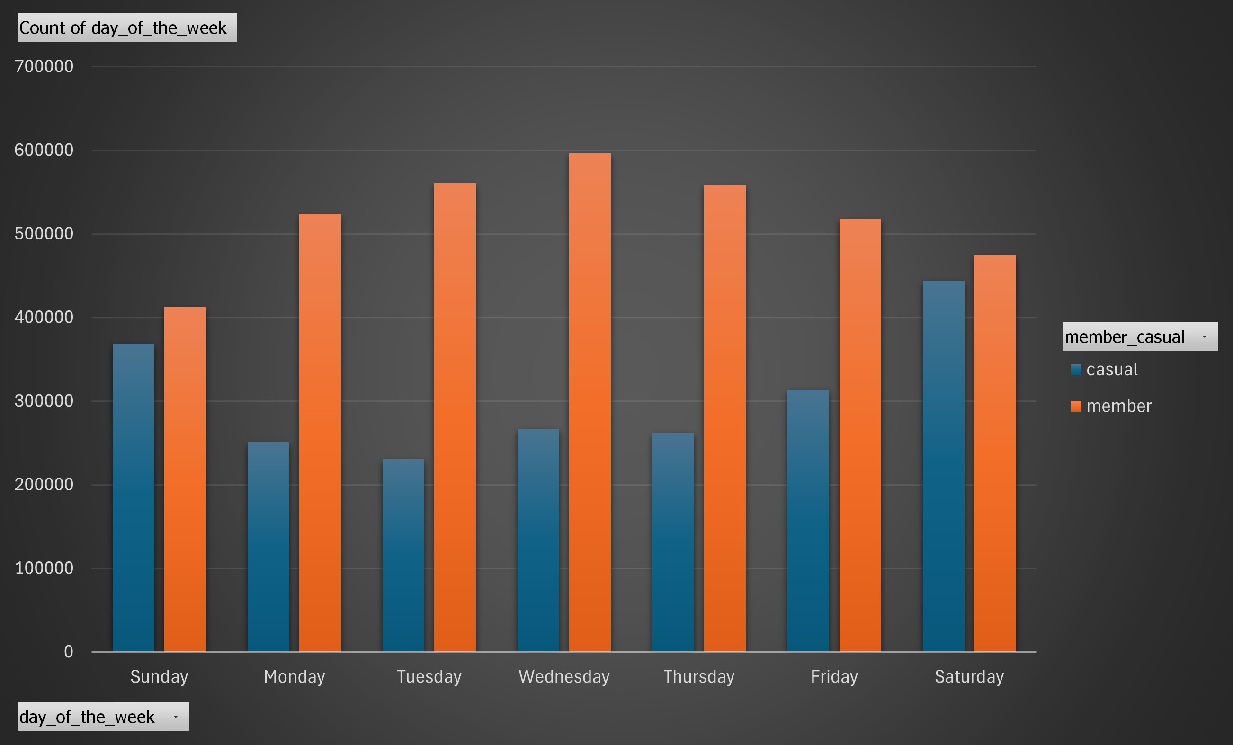
Rides per day of the week
Members ride more during the week.
Casuals ride about as much as members do on the weekend.
Members: Highest day = Wednesday (596,140) & Lowest day = Sunday (412,384)
Casuals: highest day = Saturday (443,925) & lowest day = Tuesday (230,394)
Notes:
This also shows that even on members lowest day, Sunday, the casuals only surpassed that number one day a week, Saturday.

Slide 5
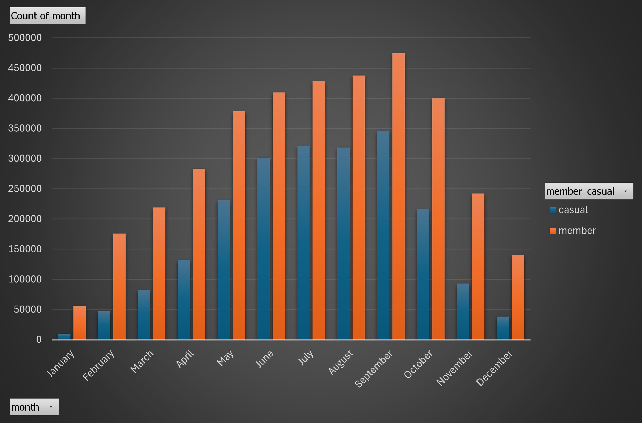
Rides by month
The top 3 months based on number of rides are September (820,867), August (755,804), & July (749,004).
The 3 slowest months based on number of rides are January (65,532), December (178,359), & February (223,164)

Slide 6
Rides by season
Spring (March, April, & May): 1,326,416 total rides. 880,906 rides by members. 445,510 rides by casuals.
Summer (June, July, & August):2,215,555 total rides. 1,275,407 rides by members. 940,148 rides by casuals.
Fall (September, October, & November): 1,772,201 total rides. 1,116,193 rides by members. 656,008 rides by casuals.
Winter (December, January, & February): 467,055 total rides. 371,755 rides by members, 95,300 rides by casuals.

Slide 7
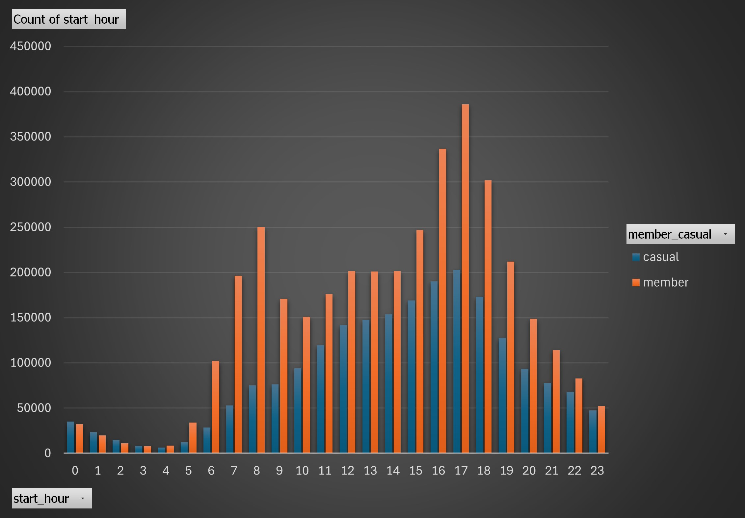
Rides by start hour
Rush hour, 6am-8am: 603,253 & 4pm-6pm: 1,361,771
Peak time is 4pm-6pm
Slow time is 1am-5am, all under 40,000 rides each hour
The casuals have more rides than members from midnight – 3 am

Slide 8
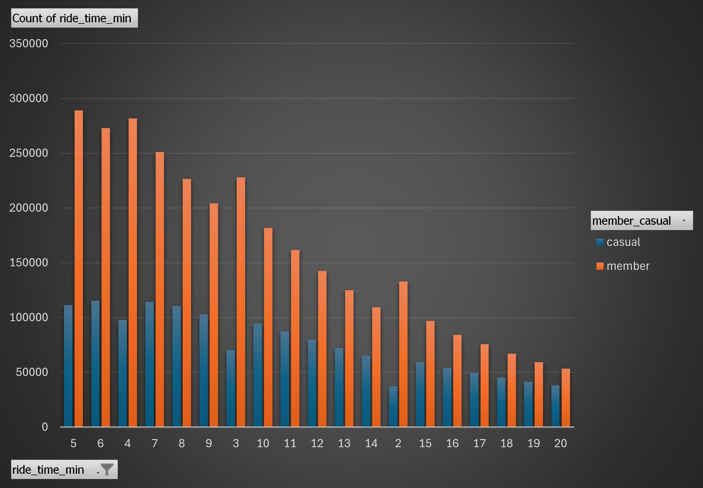
Top 10 ride times
The 7 most common ride times were less than 10 minutes
Out of the top 19 most common ride times, 20 minutes was the highest

Slide 9
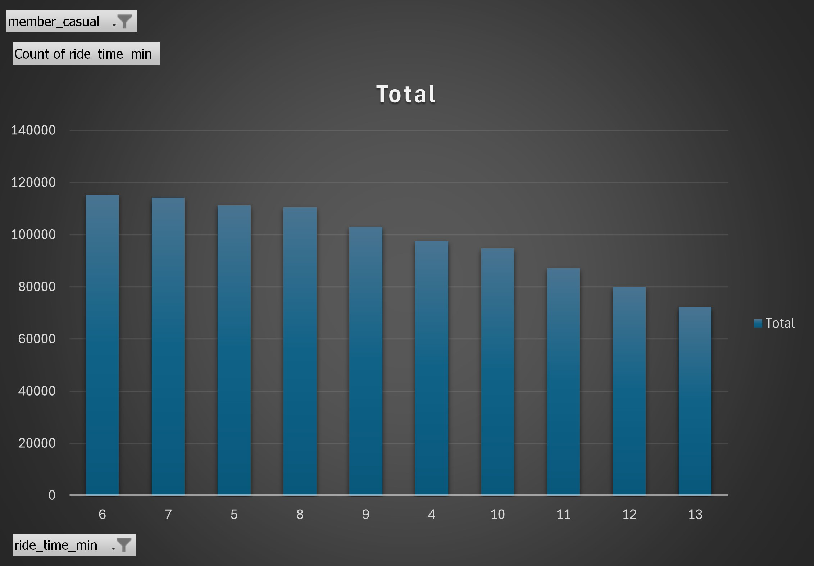
Top 10 ride times for casuals
The top 6 most common ride times for casuals were less than 10 minutes.
Out of the top 10 most common ride times for casuals 13 minutes was the longest ride time.
Typically, not sight seeing while on the bike.

Slide 10
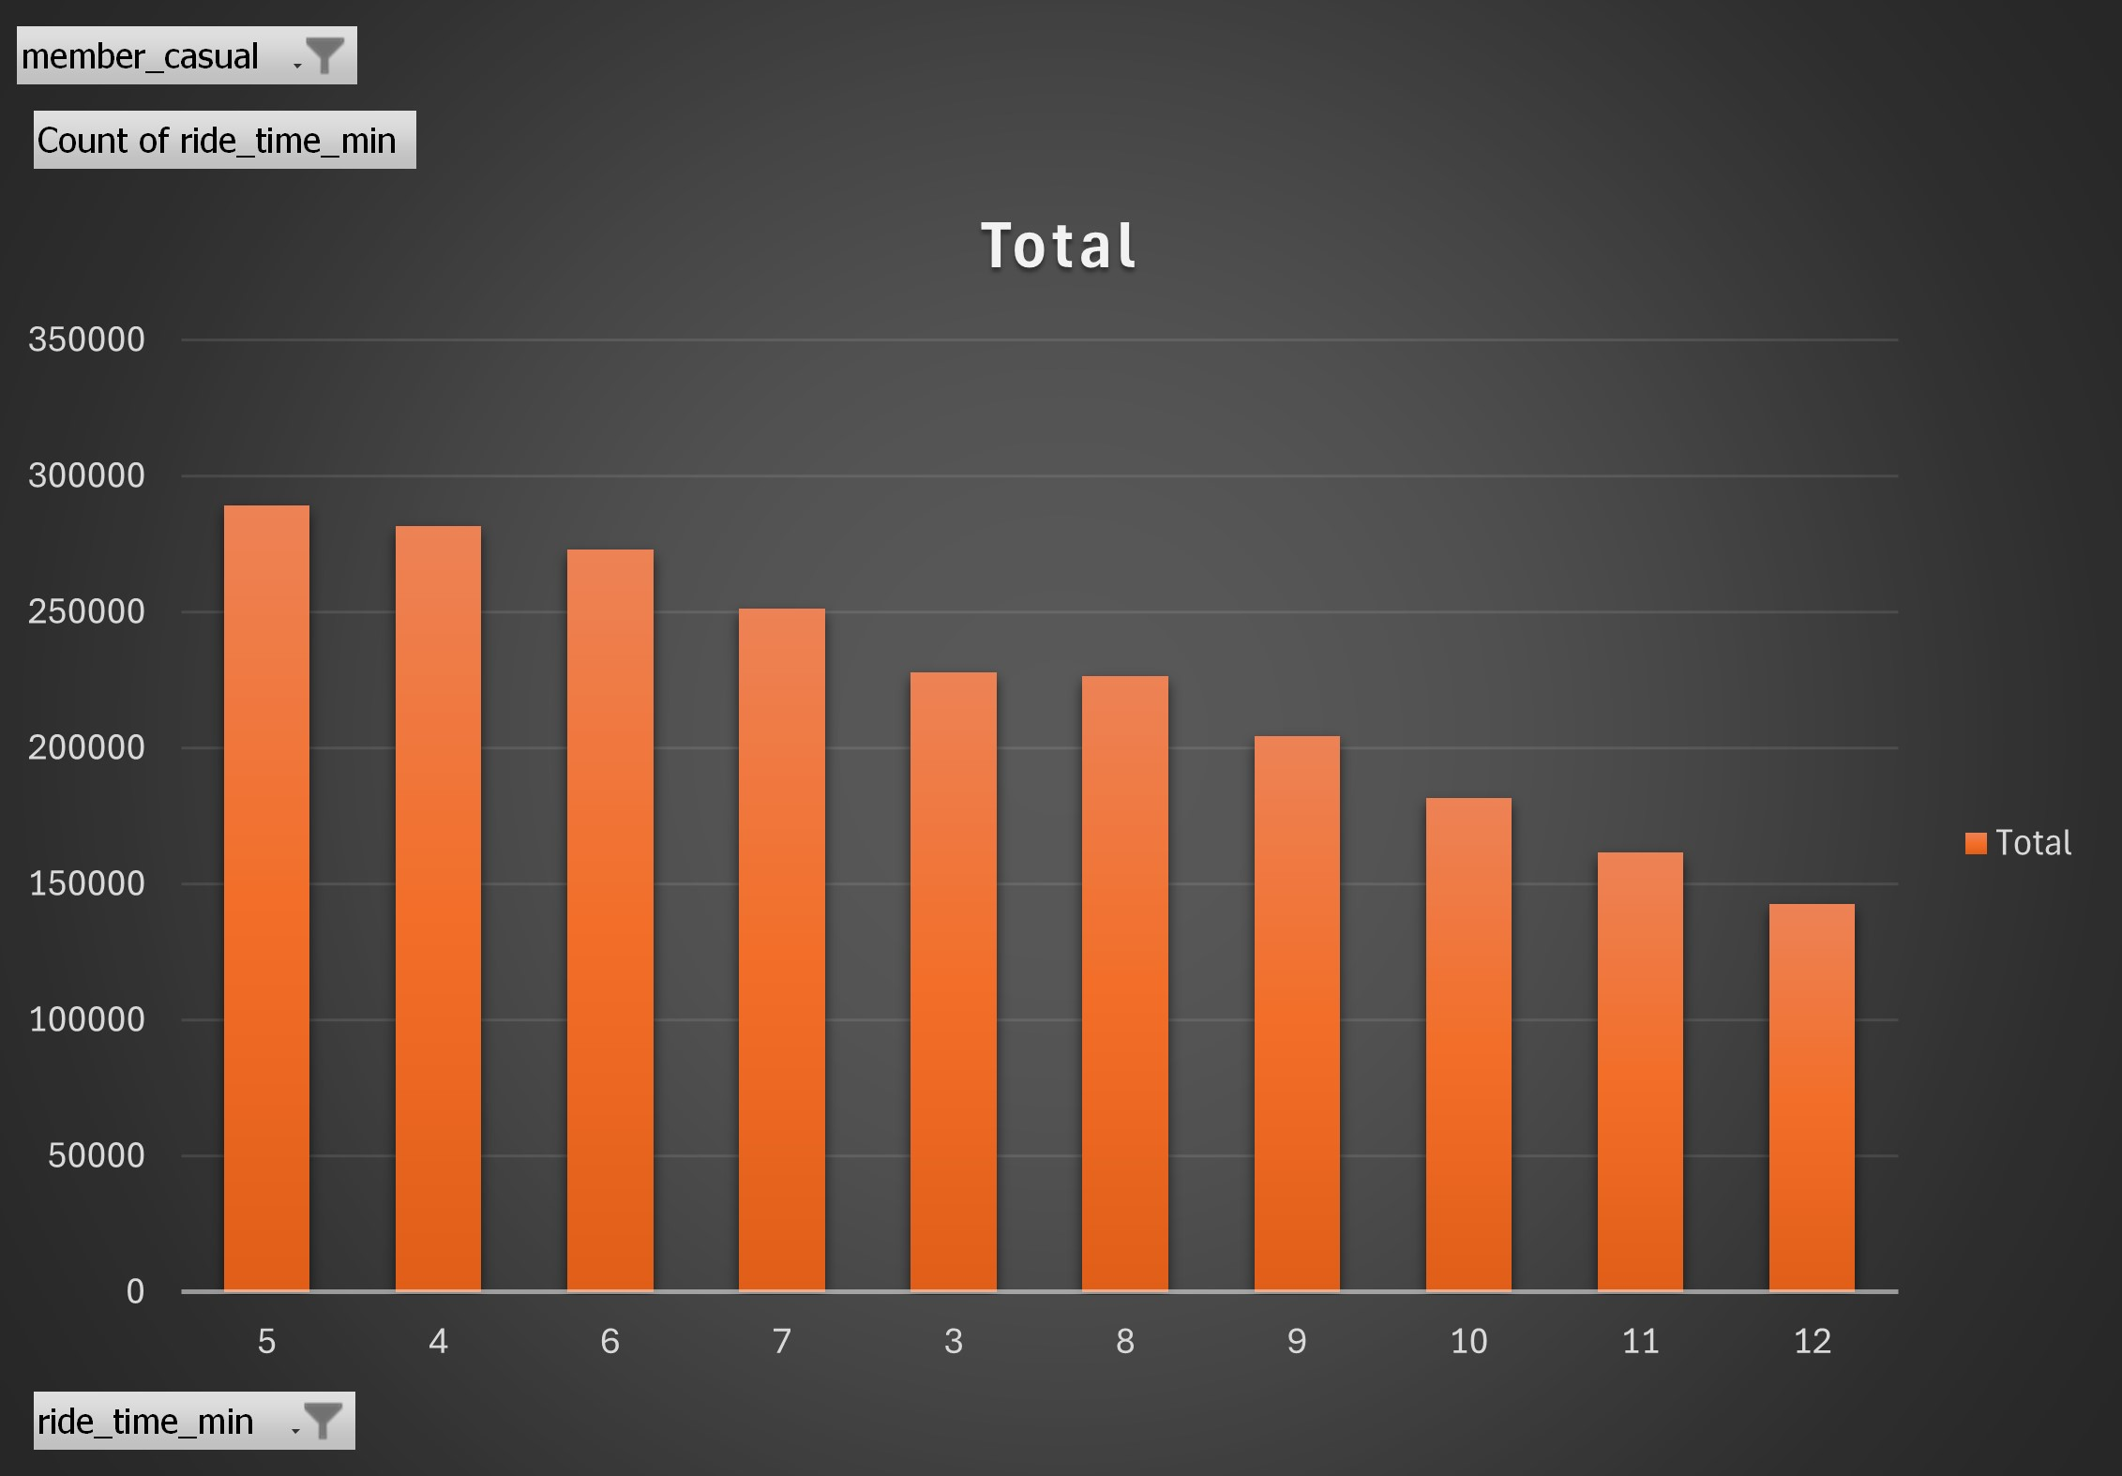
Top 10 ride times for members
The top 7 most common ride times for members were less than 10 minutes.
Out of the top 10 most common ride times for members 12 minutes was the longest ride time.
Again, not much sight seeing.

Slide 11
Members vs casuals
Casuals ride about as much as members on Saturdays and Sundays.
Members ride much more than casuals Monday – Friday.
The summer & fall seasons are the 2 highest seasons for both casuals & members.
Peak time of riding is from 4pm – 6pm. Morning rush hour is not as high as expected.
Top 7 ride lengths are 10 minutes or less & Top 19 ride lengths are 20 minutes or less
Both casuals & members have the same tendencies for ride time, rides per month, & rides by starting hour.

Slide 12
Suggestions
Options to convert casuals to members include:
Weekend Warrior Pass: 3-day pass
Visitor Pass: 7-day pass
Local Pass: 3-month pass
Dash pass: 10-rides under 20 minutes
Cons: Want to convert casuals to members without losing the profit from annual memberships.
Notes:
Weekend Warrior Pass: Casuals highest volume of rides is on Saturday & Sunday. Will they be willing to sign up for a 3 day weekend pass?
Visitor Pass: Hope to get the tourist who are visiting for a week?
Local: 3-month pass with hopes of renewals for summer, fall, and spring.
Dash Pass: playing off the top 20 most common ride times all being under 20 minutes.

Slide 13
Conclusion
I believe the data supports the Weekend Warrior and Local passes.
With the casuals highest volume of rides being Friday and Saturday I believe we can convert them to the Weekend Warrior Pass. Meet with the business department to determine if it should be each weekend or a monthly subscription.
With the weather in Chicago rides dip significantly in winter. By allowing casuals to subscribe in 3-month spans I believe the increase in spring, summer, & fall will make up for the dip in winter.

Slide 14
References
Divytrip Data for this project: https://divvy-tripdata.s3.amazonaws.com/index.html
The data has been made available by Motivate International Inc. Licenses Agreement: https://divvybikes.com/data-license-agreement

